Slide 1
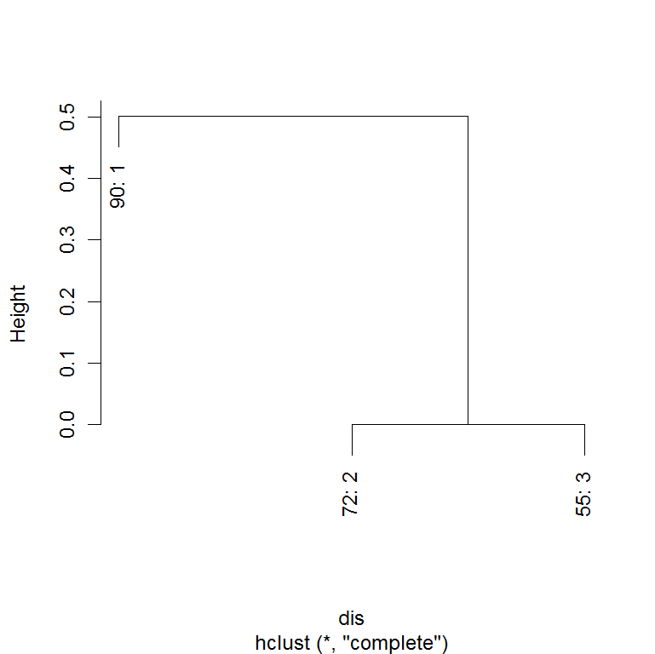
Figure 1

Slide 2
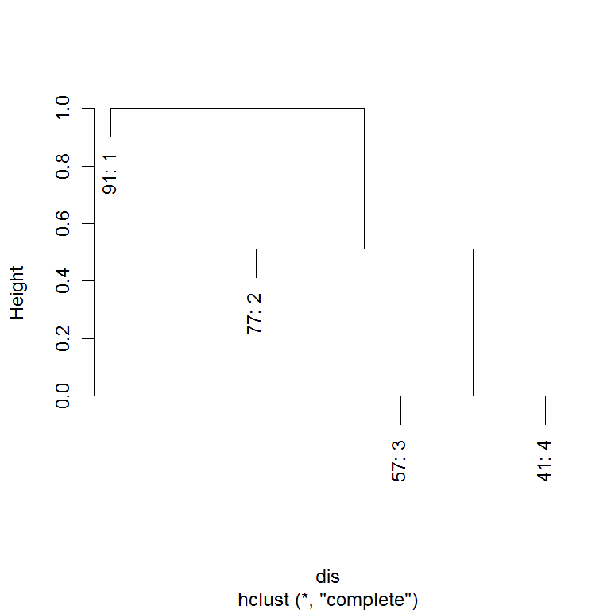
Figure 2

Slide 3
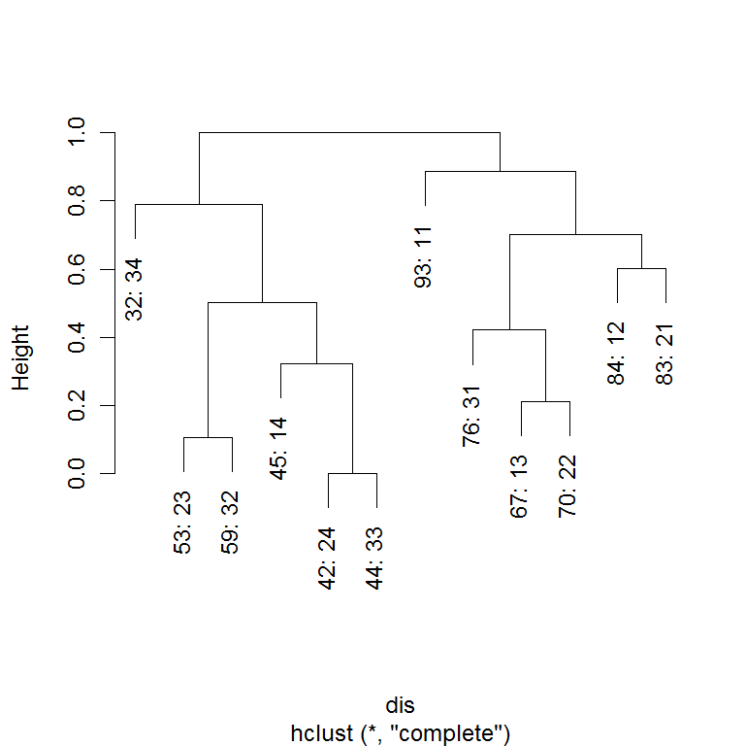
Figure 3

Slide 4
Figure 4

Slide 5
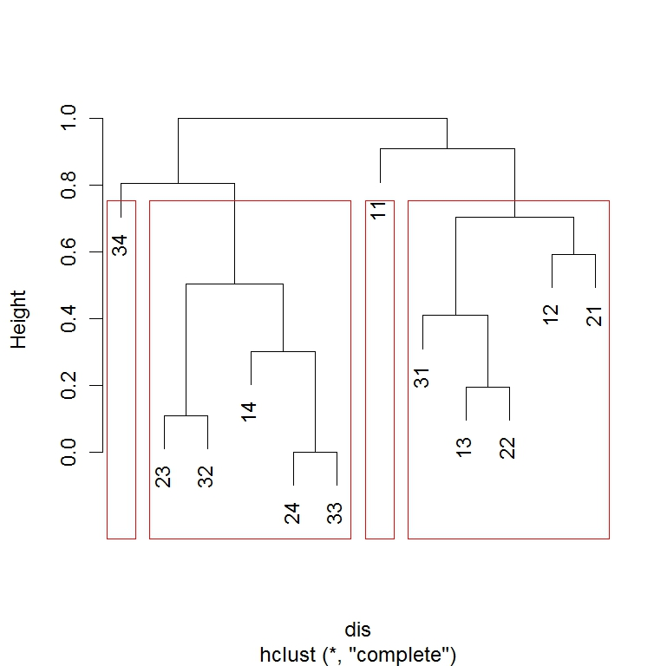
Figure 5
1
2
3
4

Slide 6
Figure 6
3
4
1
2

Slide 7
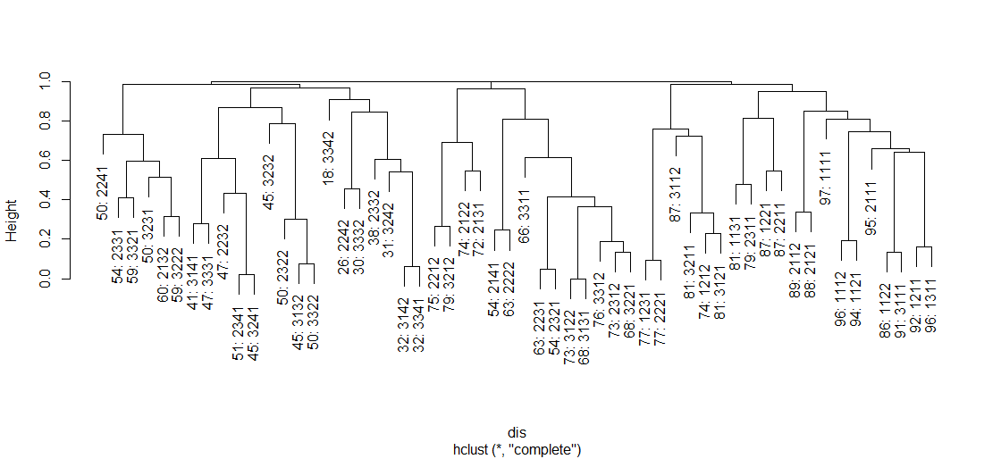
Figure 7

Slide 8
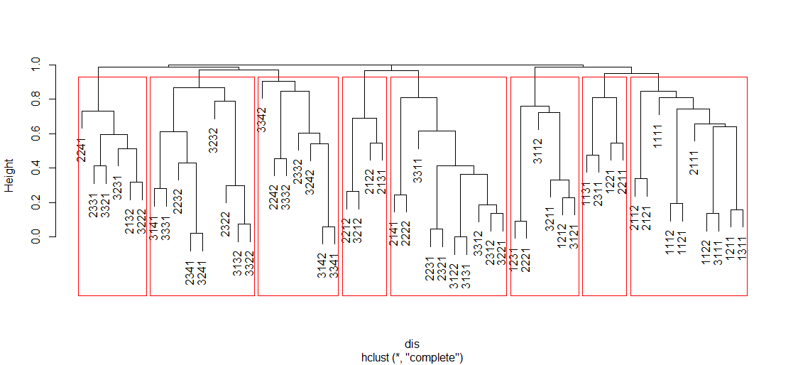
Figure 8
1
2
3
4
5
6
7
8

Slide 9
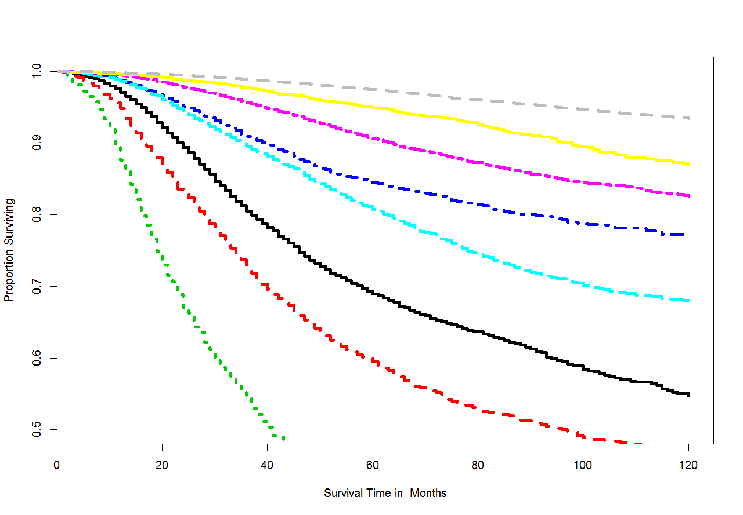
Figure 9
8
7
6
4
5
1
2
3

